Slide 1
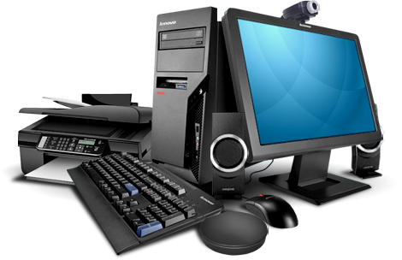


Computer
Hardware
Class V
lab 4

Slide 2

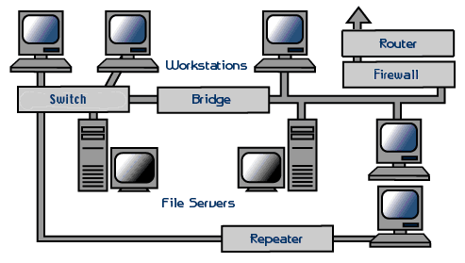
Networking Hardware
physical devices which are required for communication and interaction between devices on a computer network

Slide 3
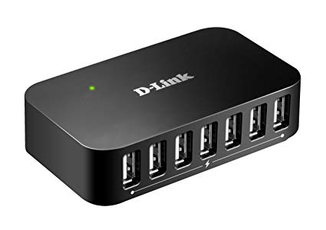
Hub
a common connection point for devices in a network

Slide 4
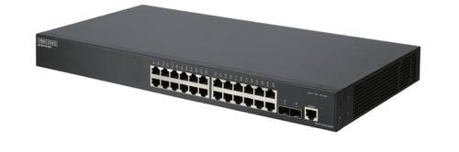
Switch
it connects devices on a computer network by using packet switching to receive, process, and forward data to the destination device

Slide 5
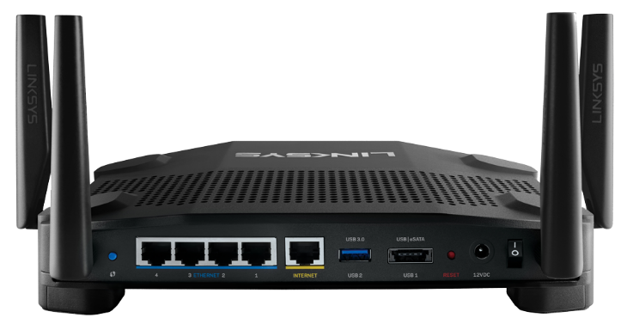
Router
A router is a networking device that forwards data packets between computer networks

Slide 6
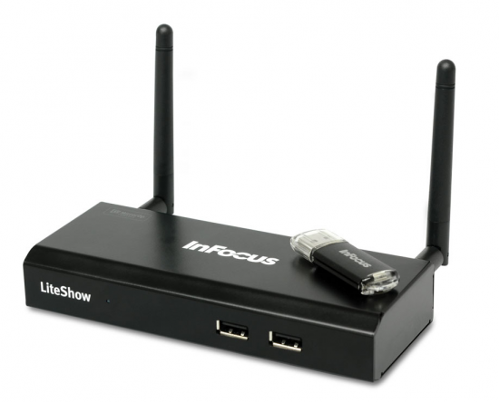
Modem
A modem is a device or program that enables a computer to transmit data over, for example, telephone or cable lines

Slide 7


